Slide 1

ELK Meetup – March 2nd 2015
Tomer Levy (tomer@logz.io ֲ@Tomerlevy)
Asaf Yigal (asaf@logz.io @asafyigal)

Slide 2
Is anyone using ELK to process logs?

Slide 3
Is anyone using the public cloud? AWS?

Slide 4
Is anyone doing kite-surfing?
Windsurfing?
Paragliding?
Sailing?

Slide 5
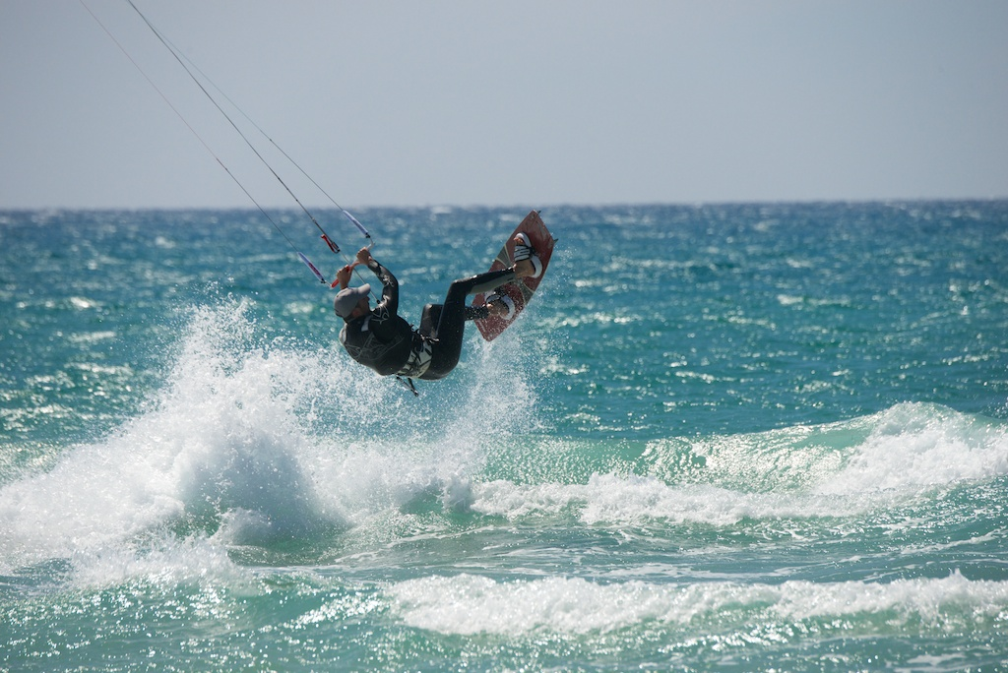
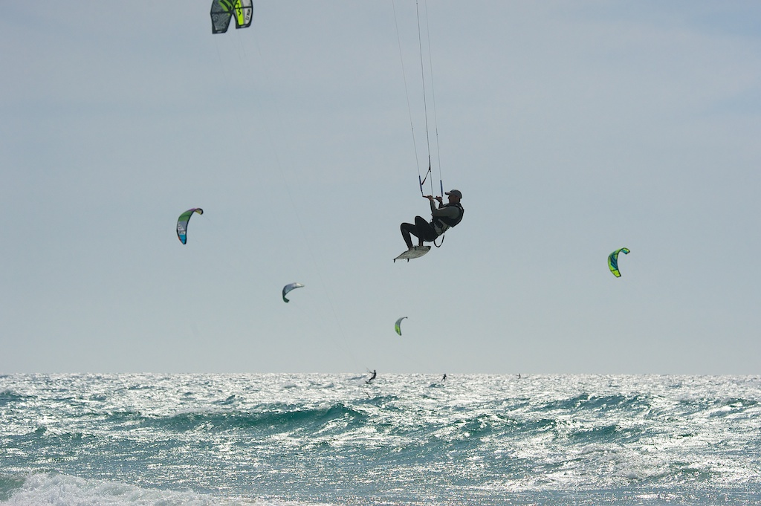
ELK – What is good for?

Slide 6

This is our office

Slide 7

And this is the view from the office

Slide 8
Our biggest challenge
When should we leave everything and go Kite-Surfing?

Slide 9
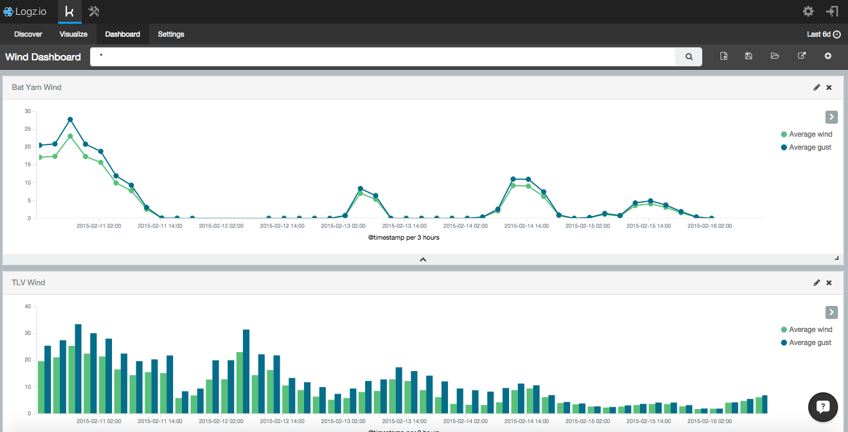
Wind Analytics

Slide 10
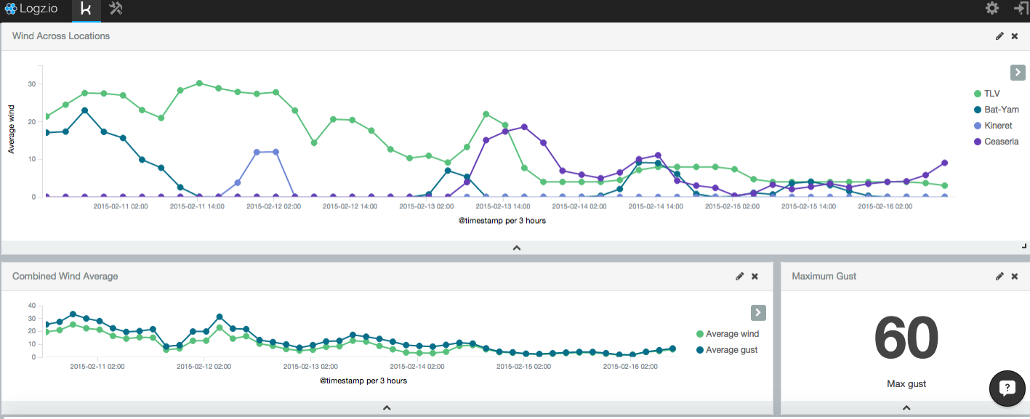
Wind Across Locations?

Slide 11
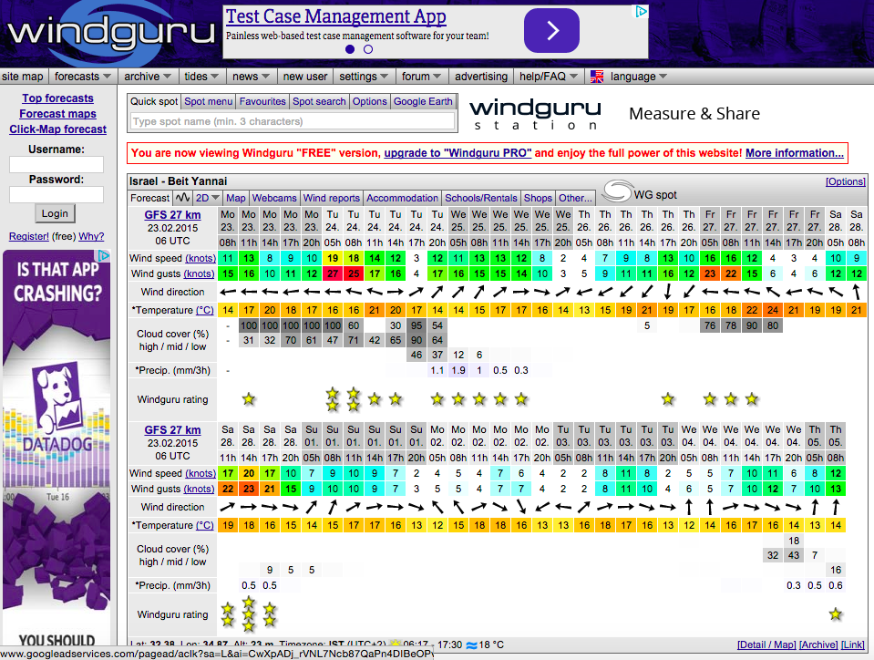
Next Steps

Slide 12
Wind Analytics – next items
Alerts
Wind forecast combined with real wind
Wind predictions!

Slide 13
Who Are We?
ELK++ as a Service
Infinitely scalable
Secured
Highly Available
Additional Features (Visual Grok, Alerts, role-based access…)
Logz.io Insights: We will tell you what queries are interesting for you
Machine Learning and Crowd Sourcing

Slide 14
How to monitor large AWS Environment?
Some tips on how to create your own ELK deployment
Shay Erlichmen @ Samba.me - demo
A live demo of Kibana 4 implementation to monitor our internal deployment

Slide 15


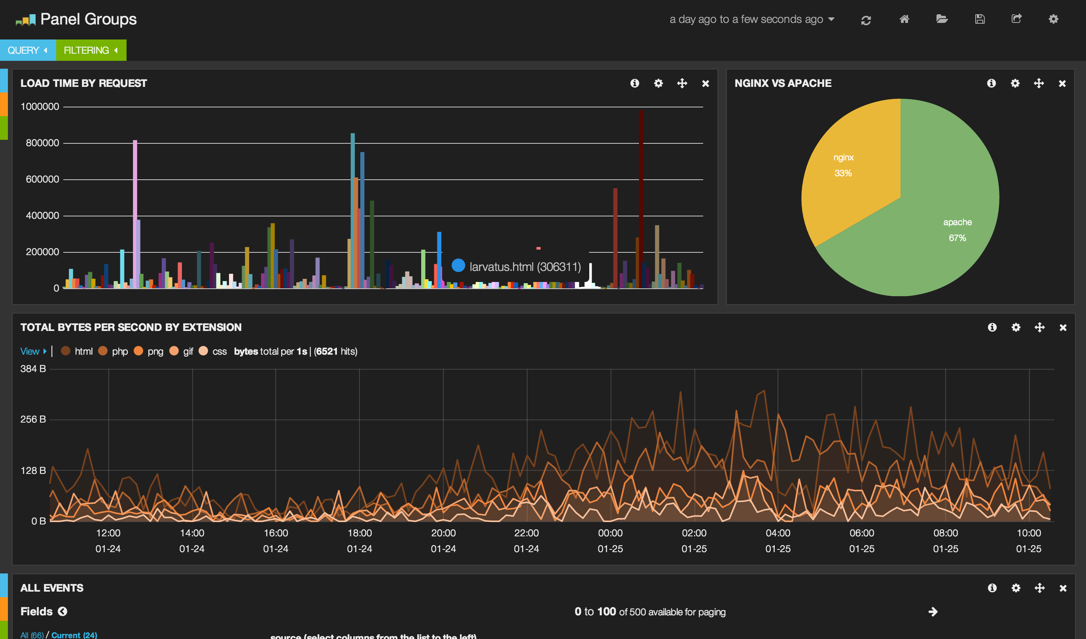



ELK implementation – creating the right architecture

Slide 16

ELK implementation – creating the right architecture
Curator
3x Master Nodes + 1 data
Curator

Slide 17
ELK implementation – creating the right architecture
3x Master Nodes + 1 data
Curator
Index Failures Handler

Slide 18


ELK Basic implementation – find the weak spots
AZ-1
LB
ELB
AZ-2

Slide 19
ELK Basic implementation - Configuration
Grok – parse logs to extract the relevant fields…
Try our blog for some help on grok/plugins etc’
blog.logz.io

Slide 20
Elasticsearch Basic implementation - Configuration
Use Elasticsearch AWS Plugin
EBS are challenging for big environment → Use PIOPS if you can afford
Don’t run AWS cluster on the same AZ (but don’t run them on different zones!)
Use Shard allocation awareness
S3 Snapshots are cool! Things tend to break…

Slide 21
Our architecture is very different – let’s look at it
DEMO

Slide 22
Let’s see a high level view of how we process log(z)
DEMO

Slide 23
Want to use the service?
Feel free to email us for any question:
tomer@logz.io
asaf@logz.io

Slide 24

We’re Hiring – Big time!
Elasticsearch Experts
Java Developers
Machine Learning Experts
Graphic Designer
Director of Marking

